Slide 1
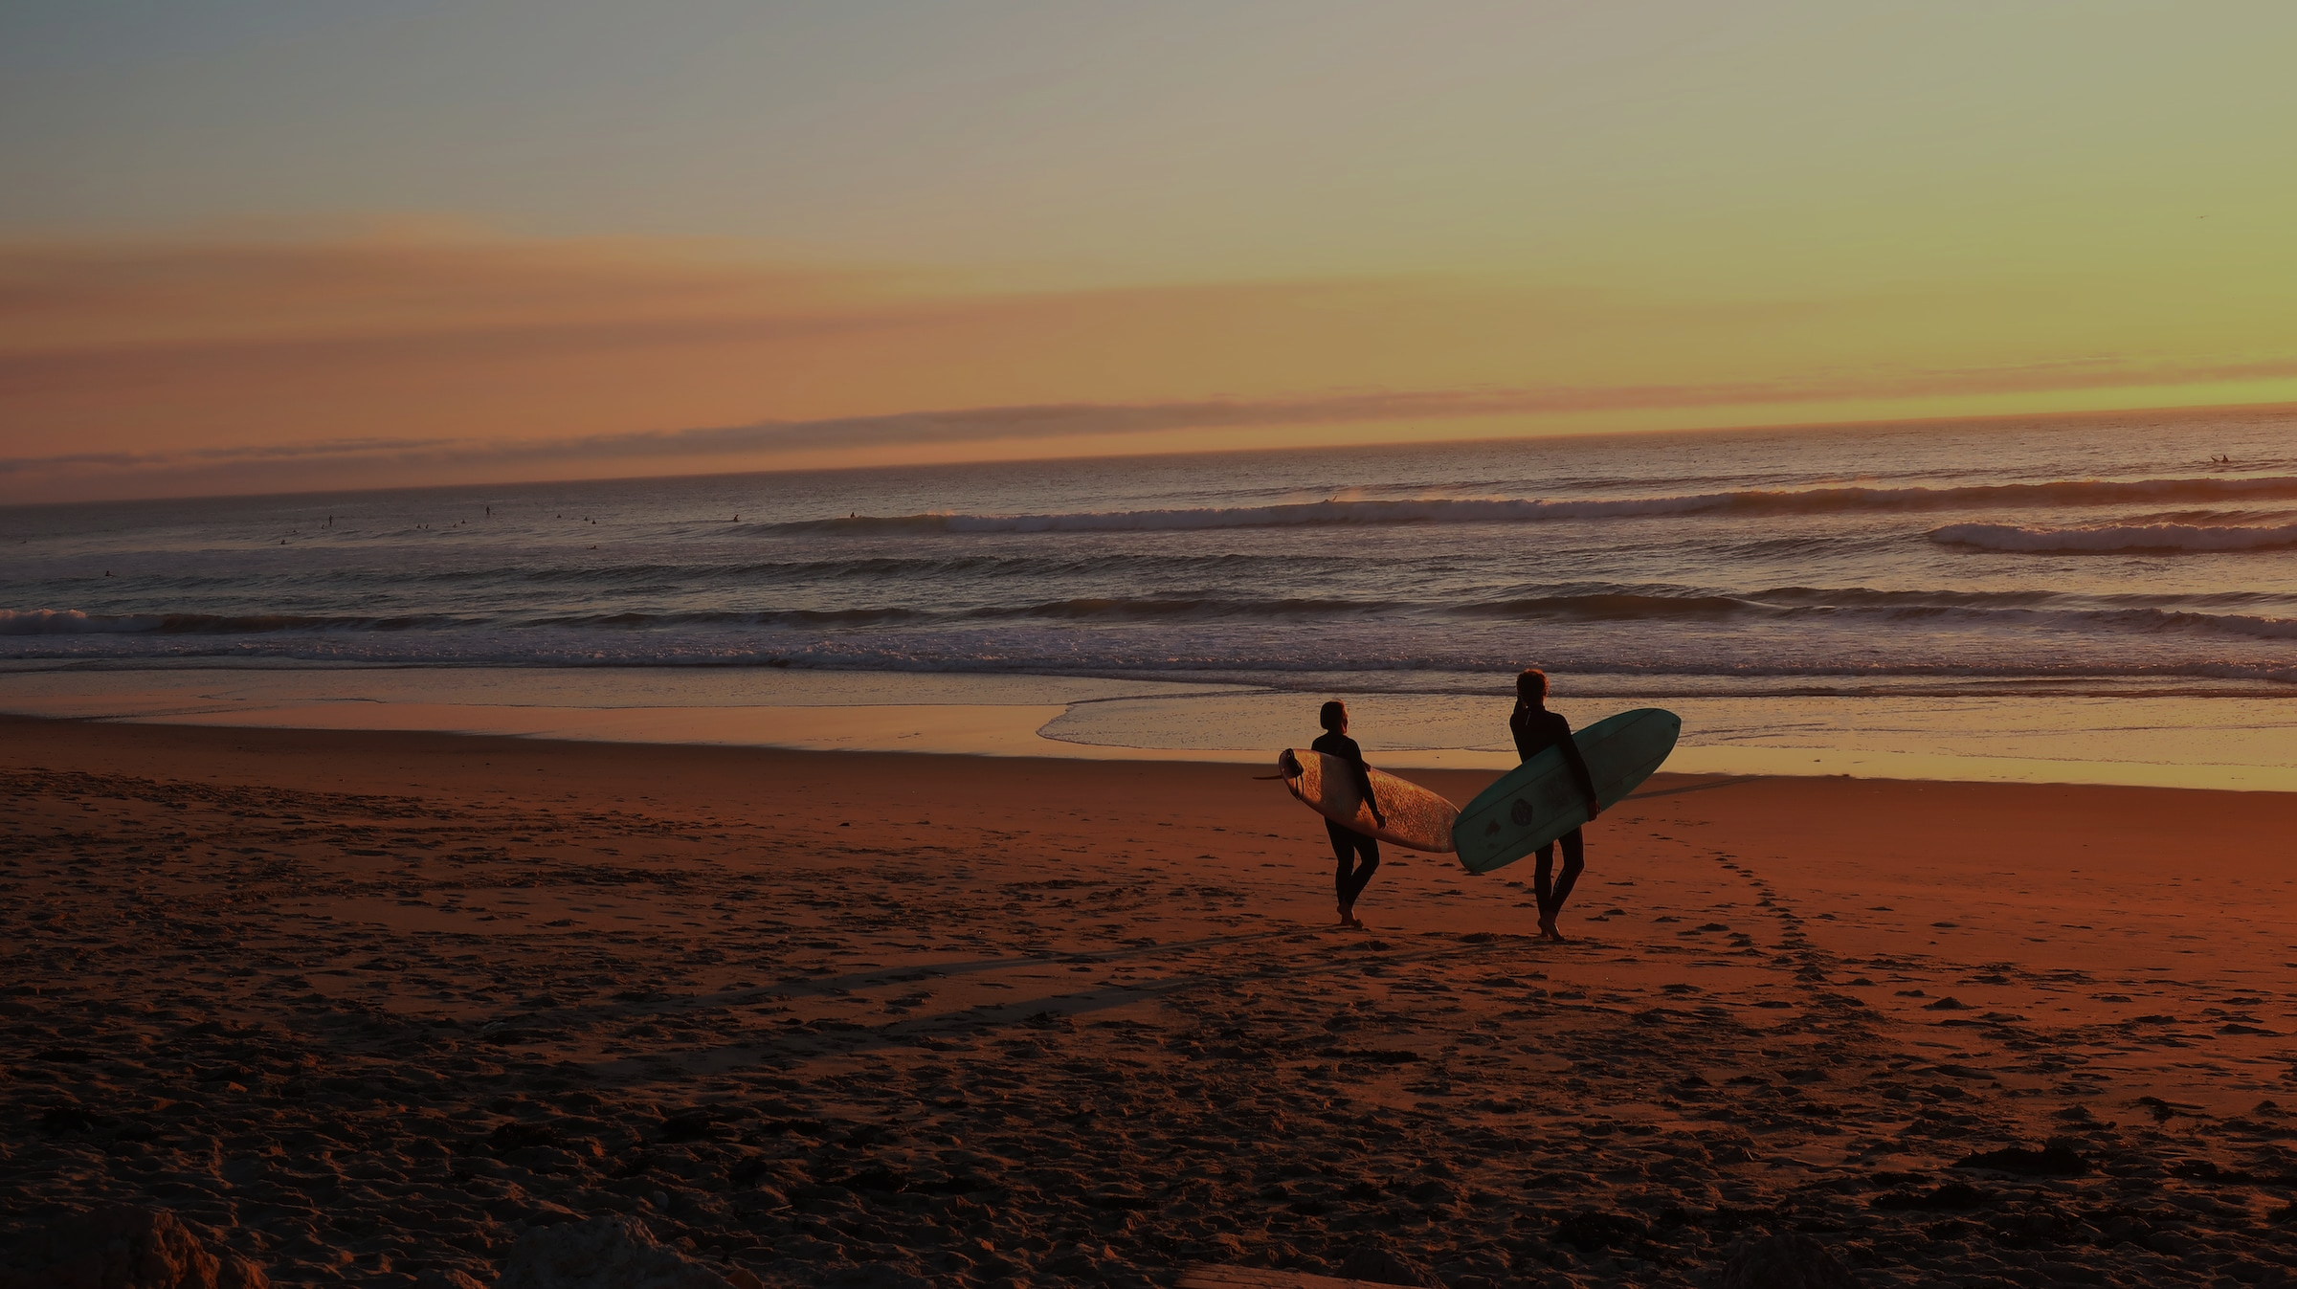
More to the Story
Lesson 2

Slide 2
What’s your opinion?
Should students have to wear uniform at school? Why or not?
What would be the worst/best thing about changing the uniform policy?
Do you think students would rather wear clothes to school that they’d feel comfortable in or that would help them fit in with others?
Notes:
Up to 10minutes

Slide 3
More of your opinion
4. What do you think there is a difference between fitting in and being accepted?
Notes:
Ans: Fitting in is doing things to be liked. Being accepted means not having to fit in to be liked.

Slide 4
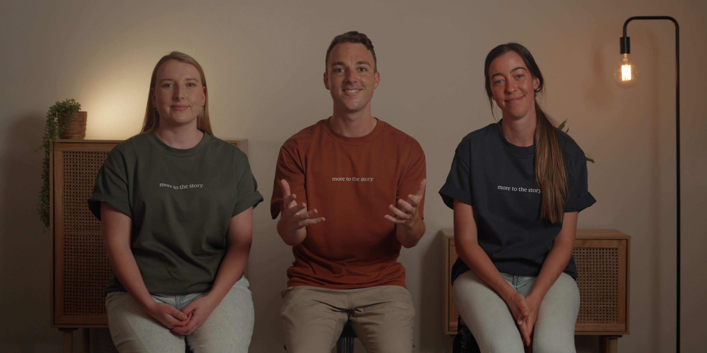
Click here to watch video
Notes:
via http://www.moretothestory.net/lesson-2

Slide 5
‘How do I find acceptance?’ Video Reflection:
  What was most interesting?
  What did you disagree with?
  What would you like to know more about?

Slide 6
Reflection Question:
If there was a God who could really know you
and truly accept you,
what would it mean for you?

Slide 7
Worksheet Activities:
STUDENT WORKSHEET
Lesson 2:

Slide 8
Jesus & the Woman at the Well: John 4: 1 - 30
4 Now Jesus learned that the Pharisees had heard that he was gaining and baptizing more disciples than John— ² although in fact it was not Jesus who baptized, but his disciples. ³ So he left Judea and went back once more to Galilee.
⁴ Now he had to go through Samaria. ⁵ So he came to a town in Samaria called Sychar, near the plot of ground Jacob had given to his son Joseph. ⁶ Jacob’s well was there, and Jesus, tired as he was from the journey, sat down by the well. It was about noon.

Slide 9
⁷ When a Samaritan woman came to draw water, Jesus said to her, “Will you give me a drink?” ⁸ (His disciples had gone into the town to buy food.)
⁹ The Samaritan woman said to him, “You are a Jew and I am a Samaritan woman. How can you ask me for a drink?” (For Jews do not associate with Samaritans.^{[a]})
¹⁰ Jesus answered her, “If you knew the gift of God and who it is that asks you for a drink, you would have asked him and he would have given you living water.”
¹¹ “Sir,” the woman said, “you have nothing to draw with and the well is deep. Where can you get this living water? ¹² Are you greater than our father Jacob, who gave us the well and drank from it himself, as did also his sons and his livestock?”

Slide 10
¹³ Jesus answered, “Everyone who drinks this water will be thirsty again, ¹⁴ but whoever drinks the water I give them will never thirst. Indeed, the water I give them will become in them a spring of water welling up to eternal life.”
¹⁵ The woman said to him, “Sir, give me this water so that I won’t get thirsty and have to keep coming here to draw water.”
¹⁶ He told her, “Go, call your husband and come back.”
¹⁷ “I have no husband,” she replied.
Jesus said to her, “You are right when you say you have no husband. ¹⁸ The fact is, you have had five husbands, and the man you now have is not your husband. What you have just said is quite true.”

Slide 11
¹⁹ “Sir,” the woman said, “I can see that you are a prophet. ²⁰ Our ancestors worshiped on this mountain, but you Jews claim that the place where we must worship is in Jerusalem.”
²¹ “Woman,” Jesus replied, “believe me, a time is coming when you will worship the Father neither on this mountain nor in Jerusalem. ²² You Samaritans worship what you do not know; we worship what we do know, for salvation is from the Jews.
²³ Yet a time is coming and has now come when the true worshipers will worship the Father in the Spirit and in truth, for they are the kind of worshipers the Father seeks. ²⁴ God is spirit, and his worshipers must worship in the Spirit and in truth.”

Slide 12
²⁵ The woman said, “I know that Messiah” (called Christ) “is coming. When he comes, he will explain everything to us.”
²⁶ Then Jesus declared, “I, the one speaking to you—I am he.”
²⁷ Just then his disciples returned and were surprised to find him talking with a woman. But no one asked, “What do you want?” or “Why are you talking with her?”
²⁸ Then, leaving her water jar, the woman went back to the town and said to the people, ²⁹ “Come, see a man who told me everything I ever did. Could this be the Messiah?” ³⁰ They came out of the town and made their way toward him.

Slide 13
Questions
Other than drinking water, what might people do at a well? (4:1-7)
What water do you think Jesus was speaking about that leaves people never thirsty? (4:13-15)
Why did the woman think Jesus was a prophet? (4:17-19)
How did the disciples feel about Jesus speaking with her? (4:27)
What does this story show us about Jesus?
How is this story about Jesus similar or different to the ‘How do I find acceptance video?’

Slide 14
Recommended Responses
1. Other than drinking water, what might people do at a well? (4:1-7)
It was a meeting place. Like a drink fountain at school. Meet, chat and drink.
2. What water do you think Jesus was speaking about that leaves people never thirsty? (4:13-15)
Jesus was referring to himself. It’s something that he offers.
3. Why did the woman think Jesus was a prophet? (4:17-19)
He knew about her past history of relationships like only a mind reader could.

Slide 15
Recommended Responses
4. How did the disciples feel about Jesus speaking with her? (4:27)
Surprised he’d talk to a woman. Culturally it wasn’t acceptable. Stunned/disapproving of him speaking to a Samaritan.
5. What does this story show us about Jesus?
Jesus knows everything we have ever thought or done and still accepts us.
6. How is this story about Jesus similar or different to the ‘How do I find acceptance video?’
Both had characters who felt ashamed over things that had them rejected.

Slide 16

Want to find out more?
www.moretothestory.net

